Slide 1
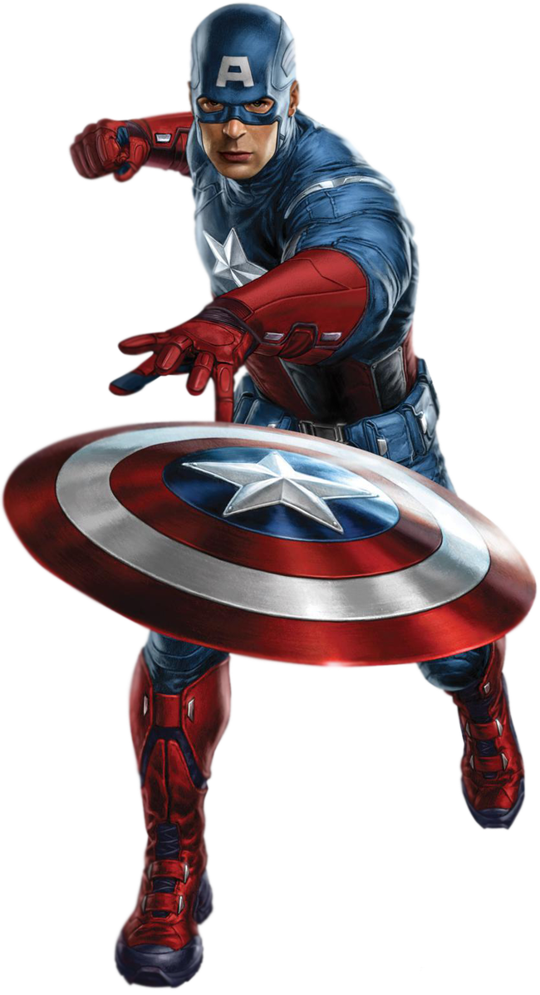
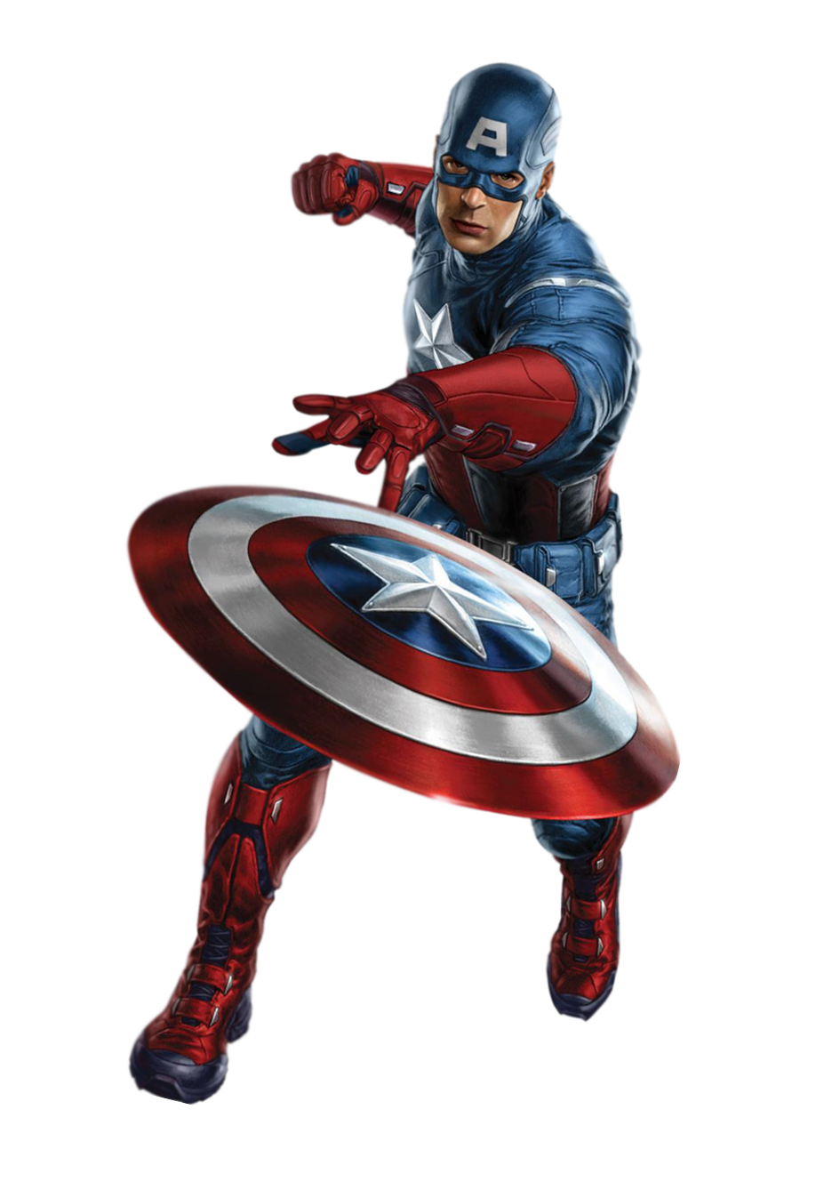
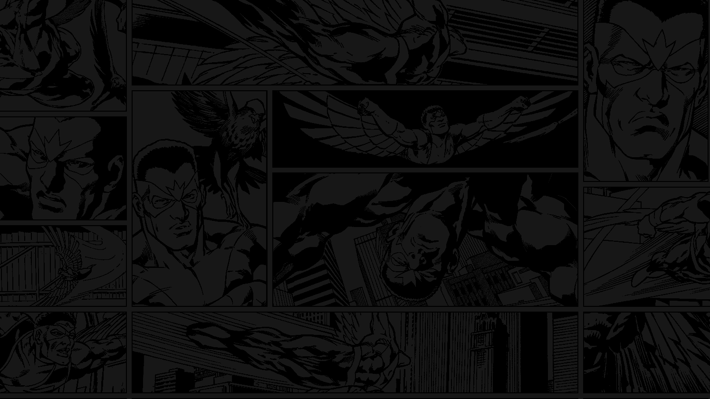
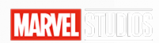

Captain America
In order to serve the country, Captain America volunteered to join the secret military plan and injected a super serum to become a super soldier. At this moment, however, Nazi spies killed the professor who invented the drug formula, making Steve the only super fighter. Under the arrangement of the government, he disguised himself as an ordinary soldier and fought with the enemy in the army.
Marvel - Avengers

Slide 2
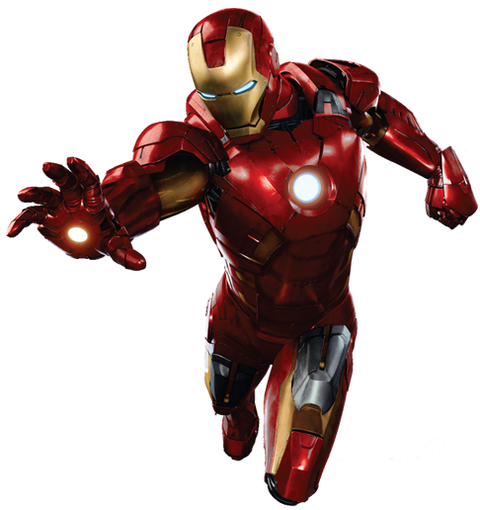
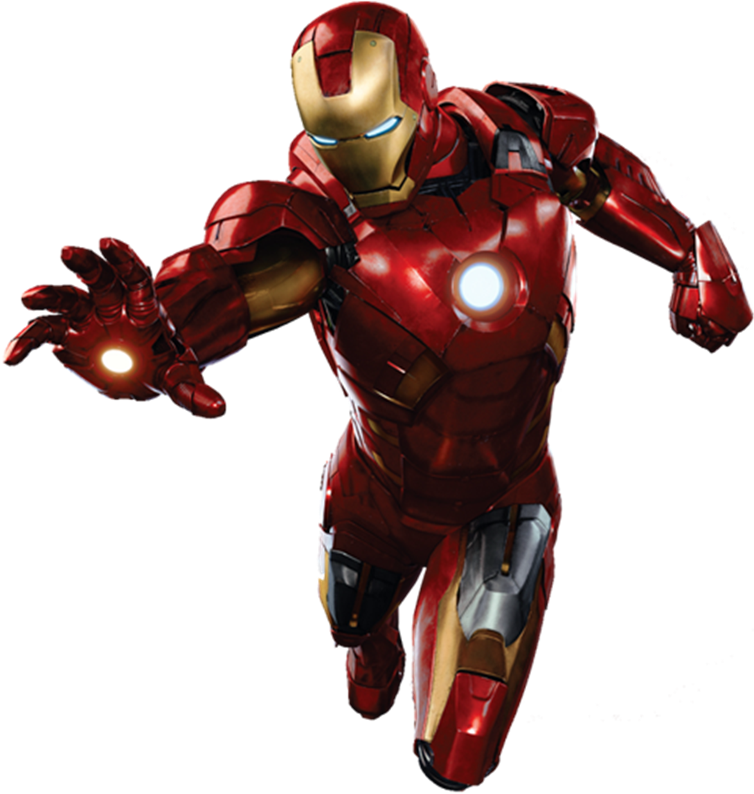

Iron - man
Tony has a genius level intellect that allows him to invent a wide range of sophisticated devices, specializing in advanced weapons and armor. He possesses a keen business mind.
Marvel - Avengers

Slide 3
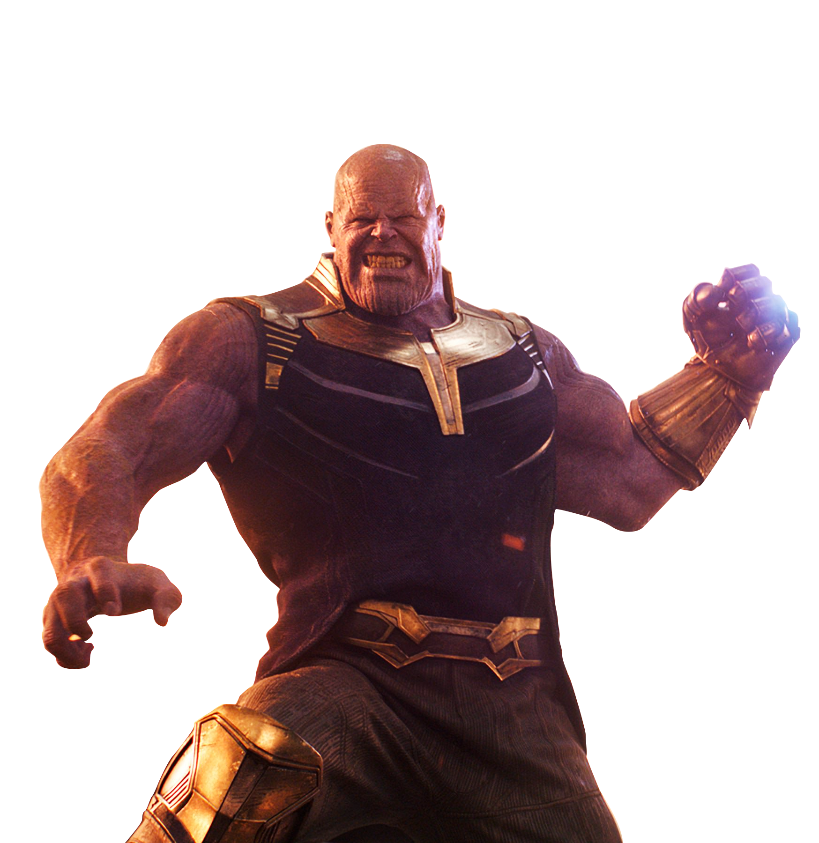
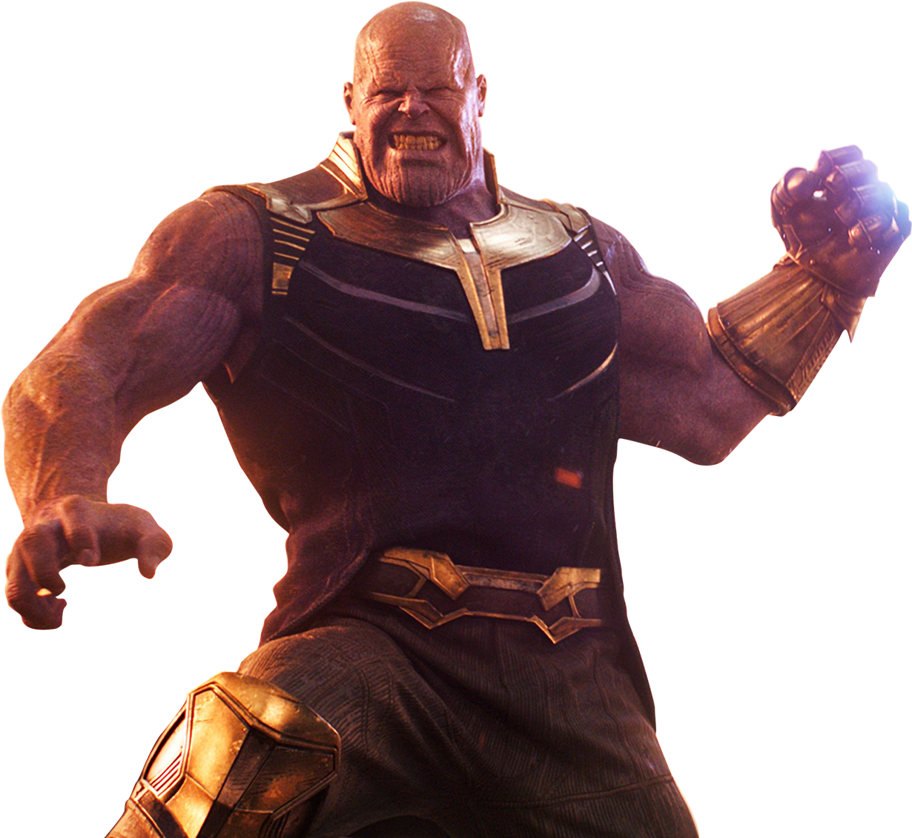
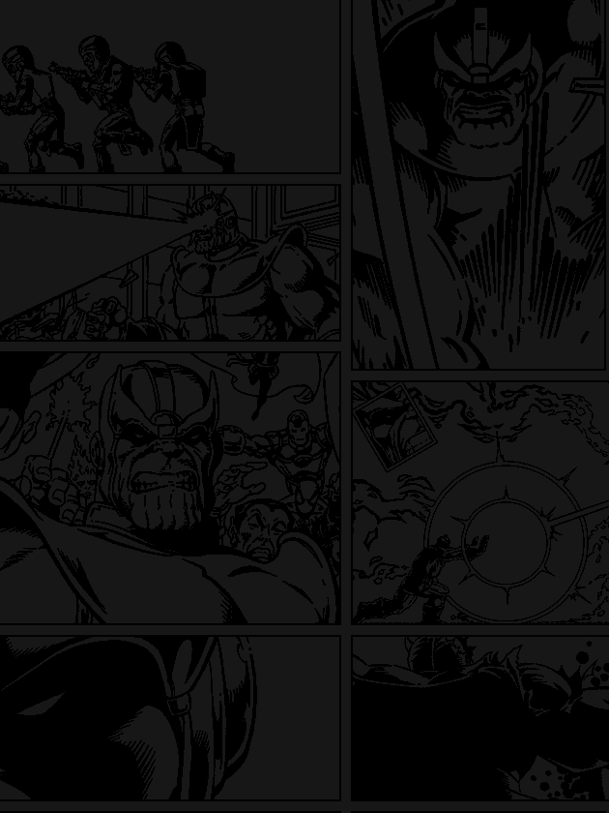
THANOS
The Mad Titan Thanos, a melancholy, brooding individual, consumed with the concept of death, sought out personal power and increased strength, endowing himself with cybernetic implants until he became more powerful than any of his brethren.
Marvel - Avengers

Slide 4
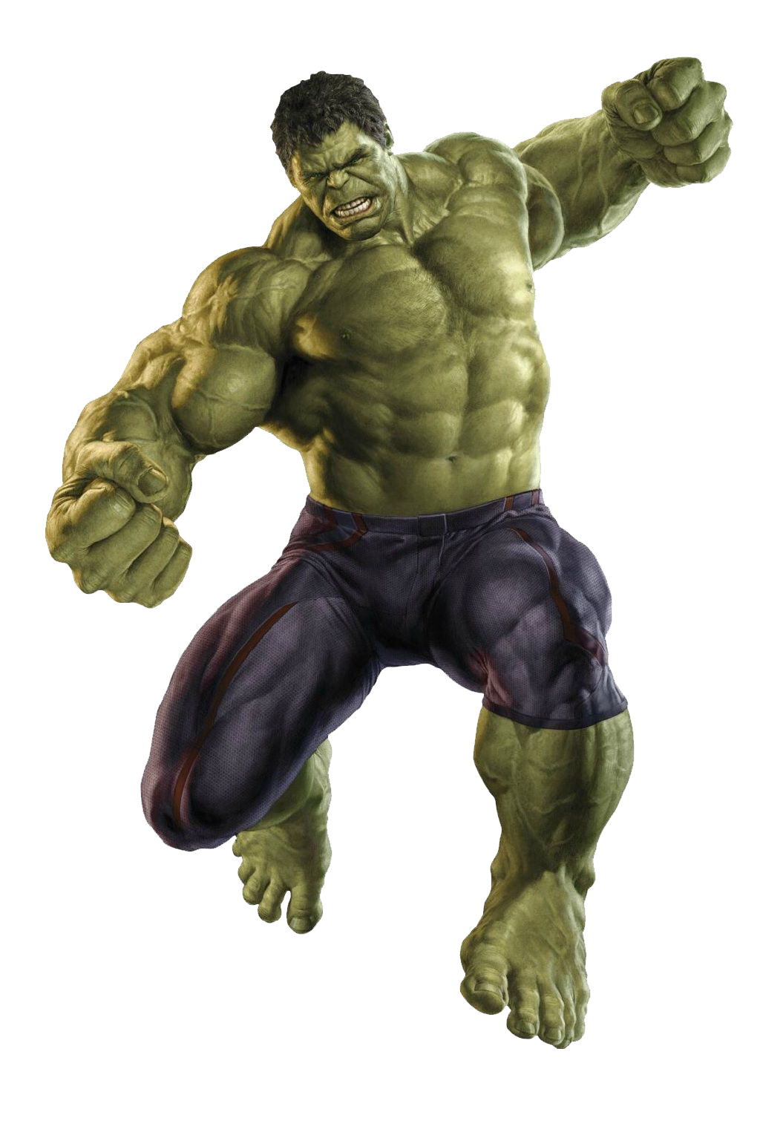
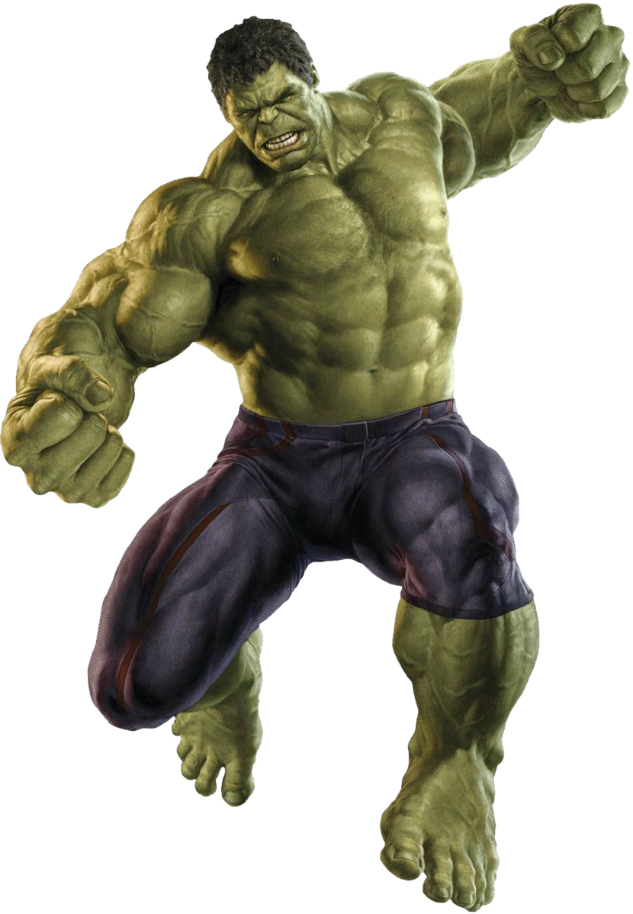
HULK
"The Incredible Hulk" is the second film in Manway's film universe. It tells that Bruce Banner, on the one hand, has to avoid the pursuit of the military, on the other hand, he is also seeking ways to control his anger, and at the same time, he has to face the threat of a powerful evil force. The film resets the story of "Bruce Banner" for the creation of Manway's film universe.
Marvel - Avengers

Slide 5
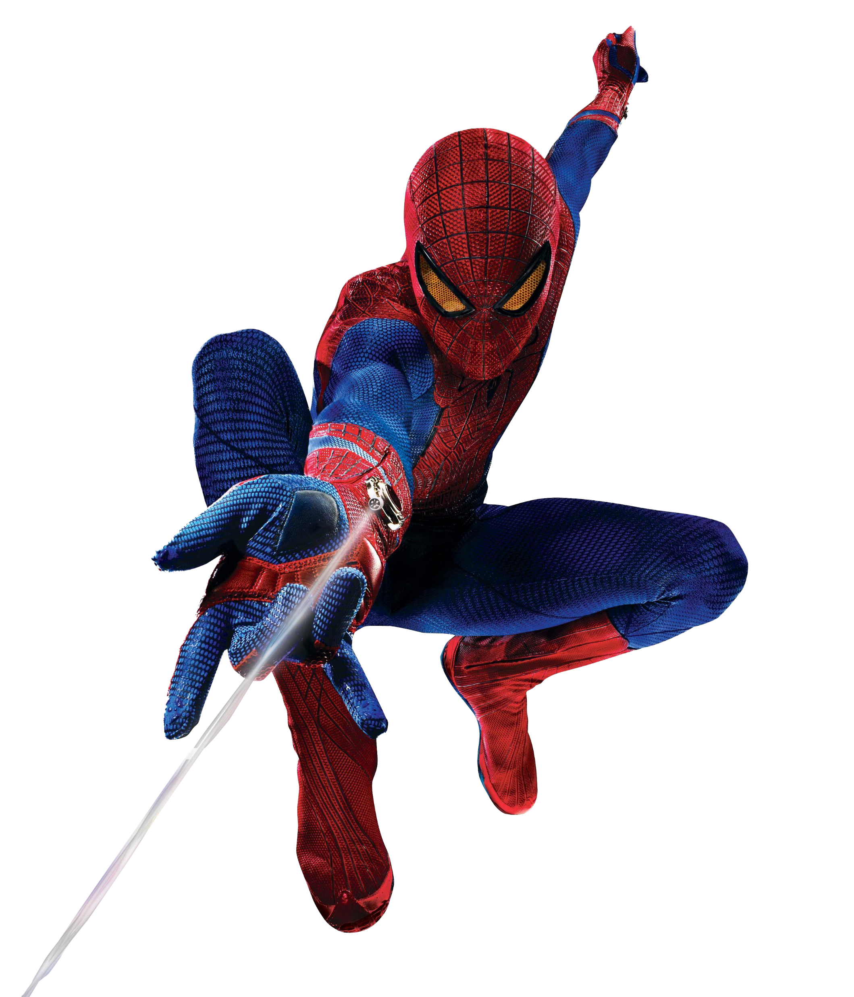
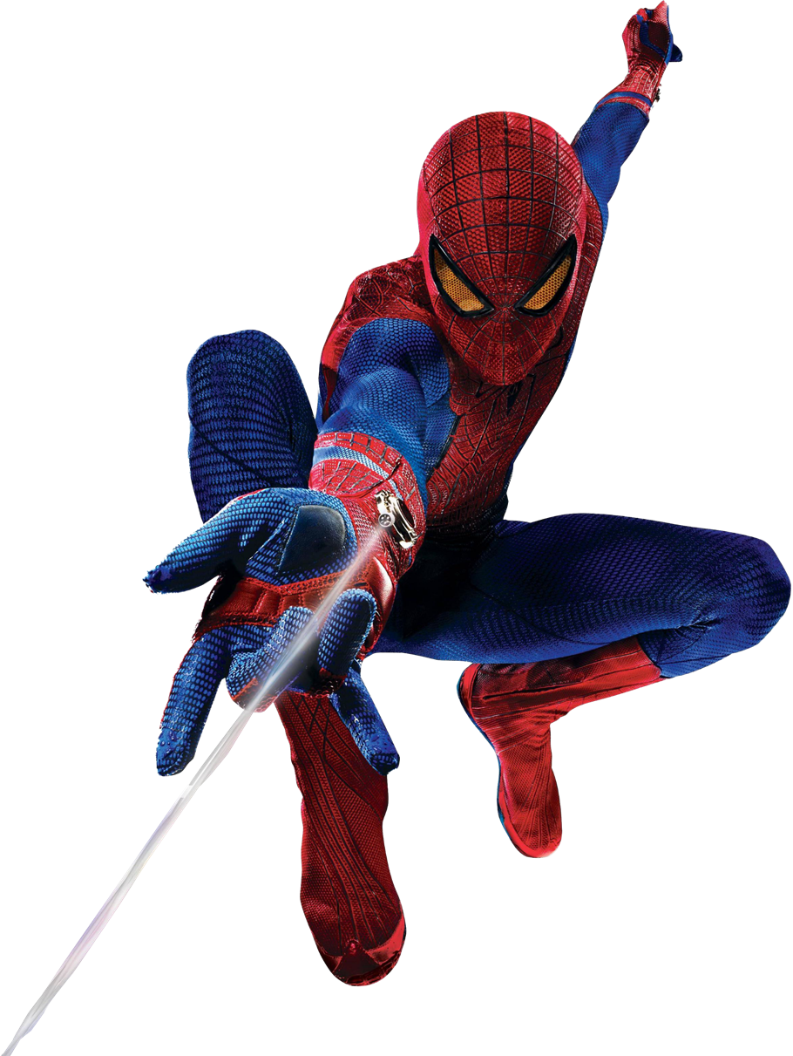
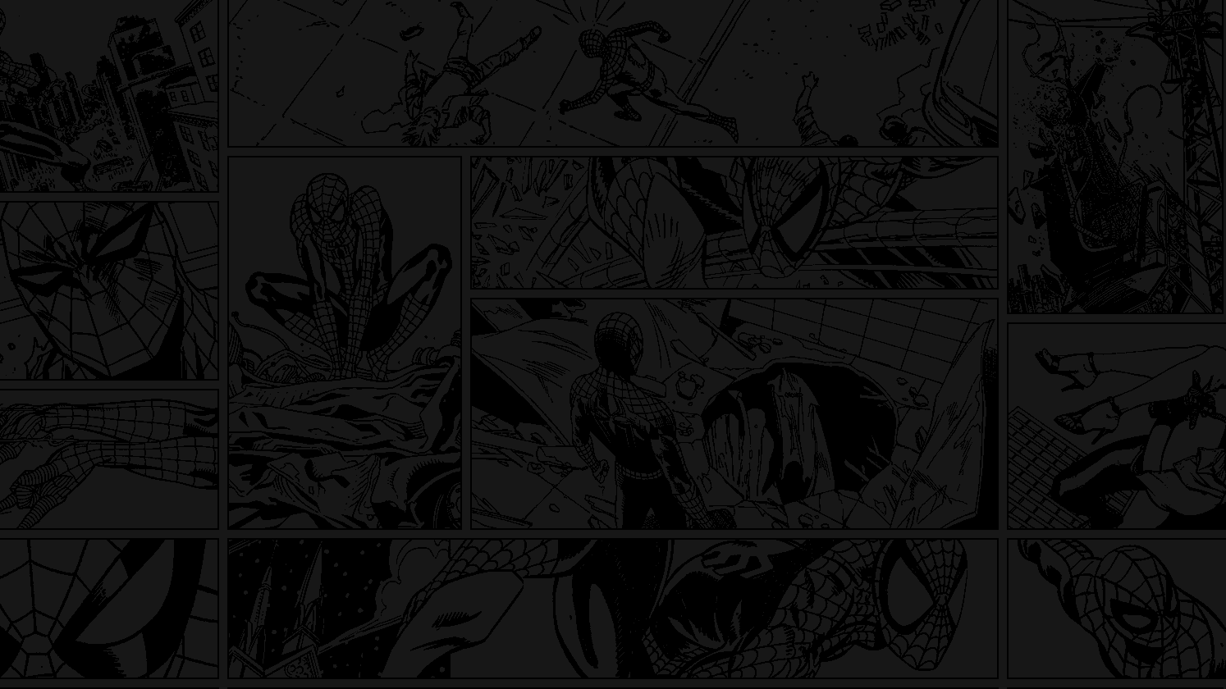
Spider - man
Bitten by a radioactive spider, high school student Peter Parker gained the speed, strength and powers of a spider. Adopting the name Spider-Man, Peter hoped to start a career using his new abilities. Taught that with great power comes great responsibility, Spidey has vowed to use his powers to help people.
Marvel - Avengers

Slide 6
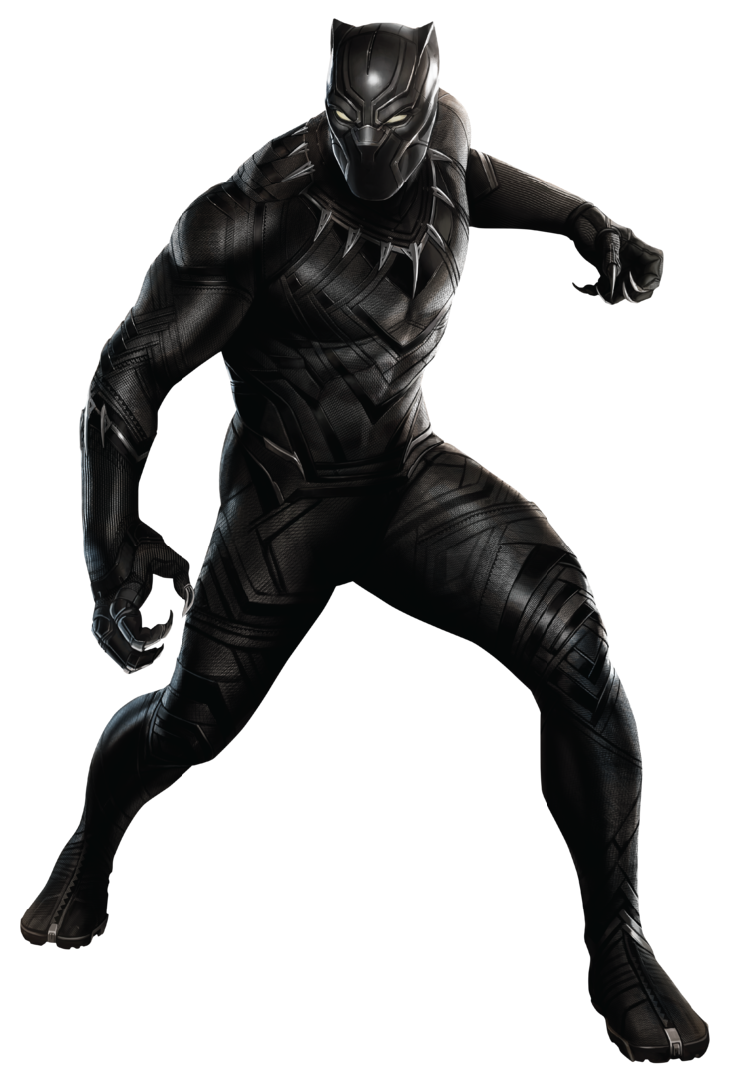
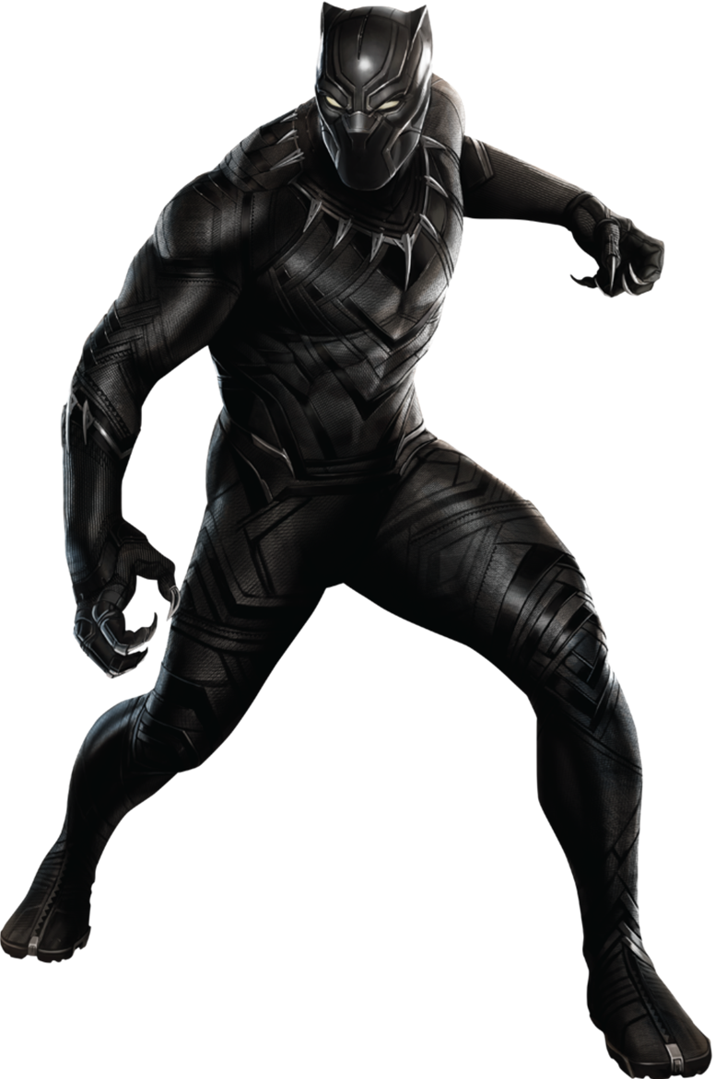
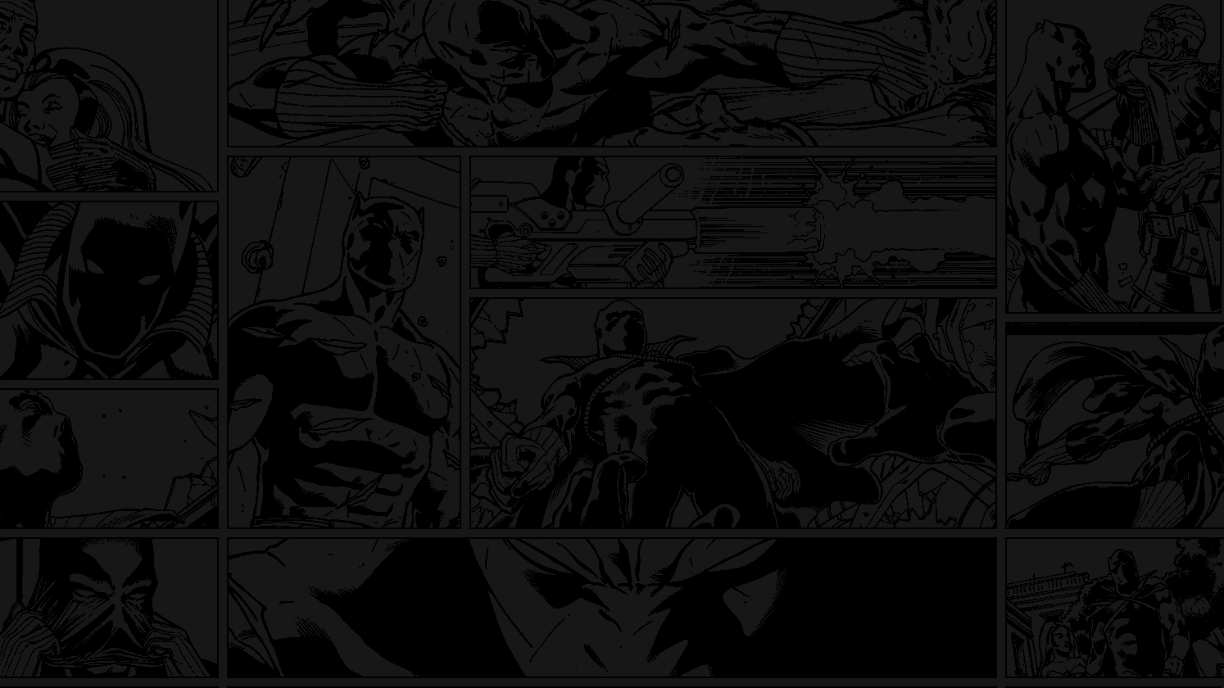
Black panther
T'Challa is a brilliant tactician, strategist, scientist, tracker and a master of all forms of unarmed combat. He is a master planner who always thinks several steps ahead and will go to extreme measures to achieve his goals and protect the kingdom of Wakanda.
Marvel - Avengers

Slide 7
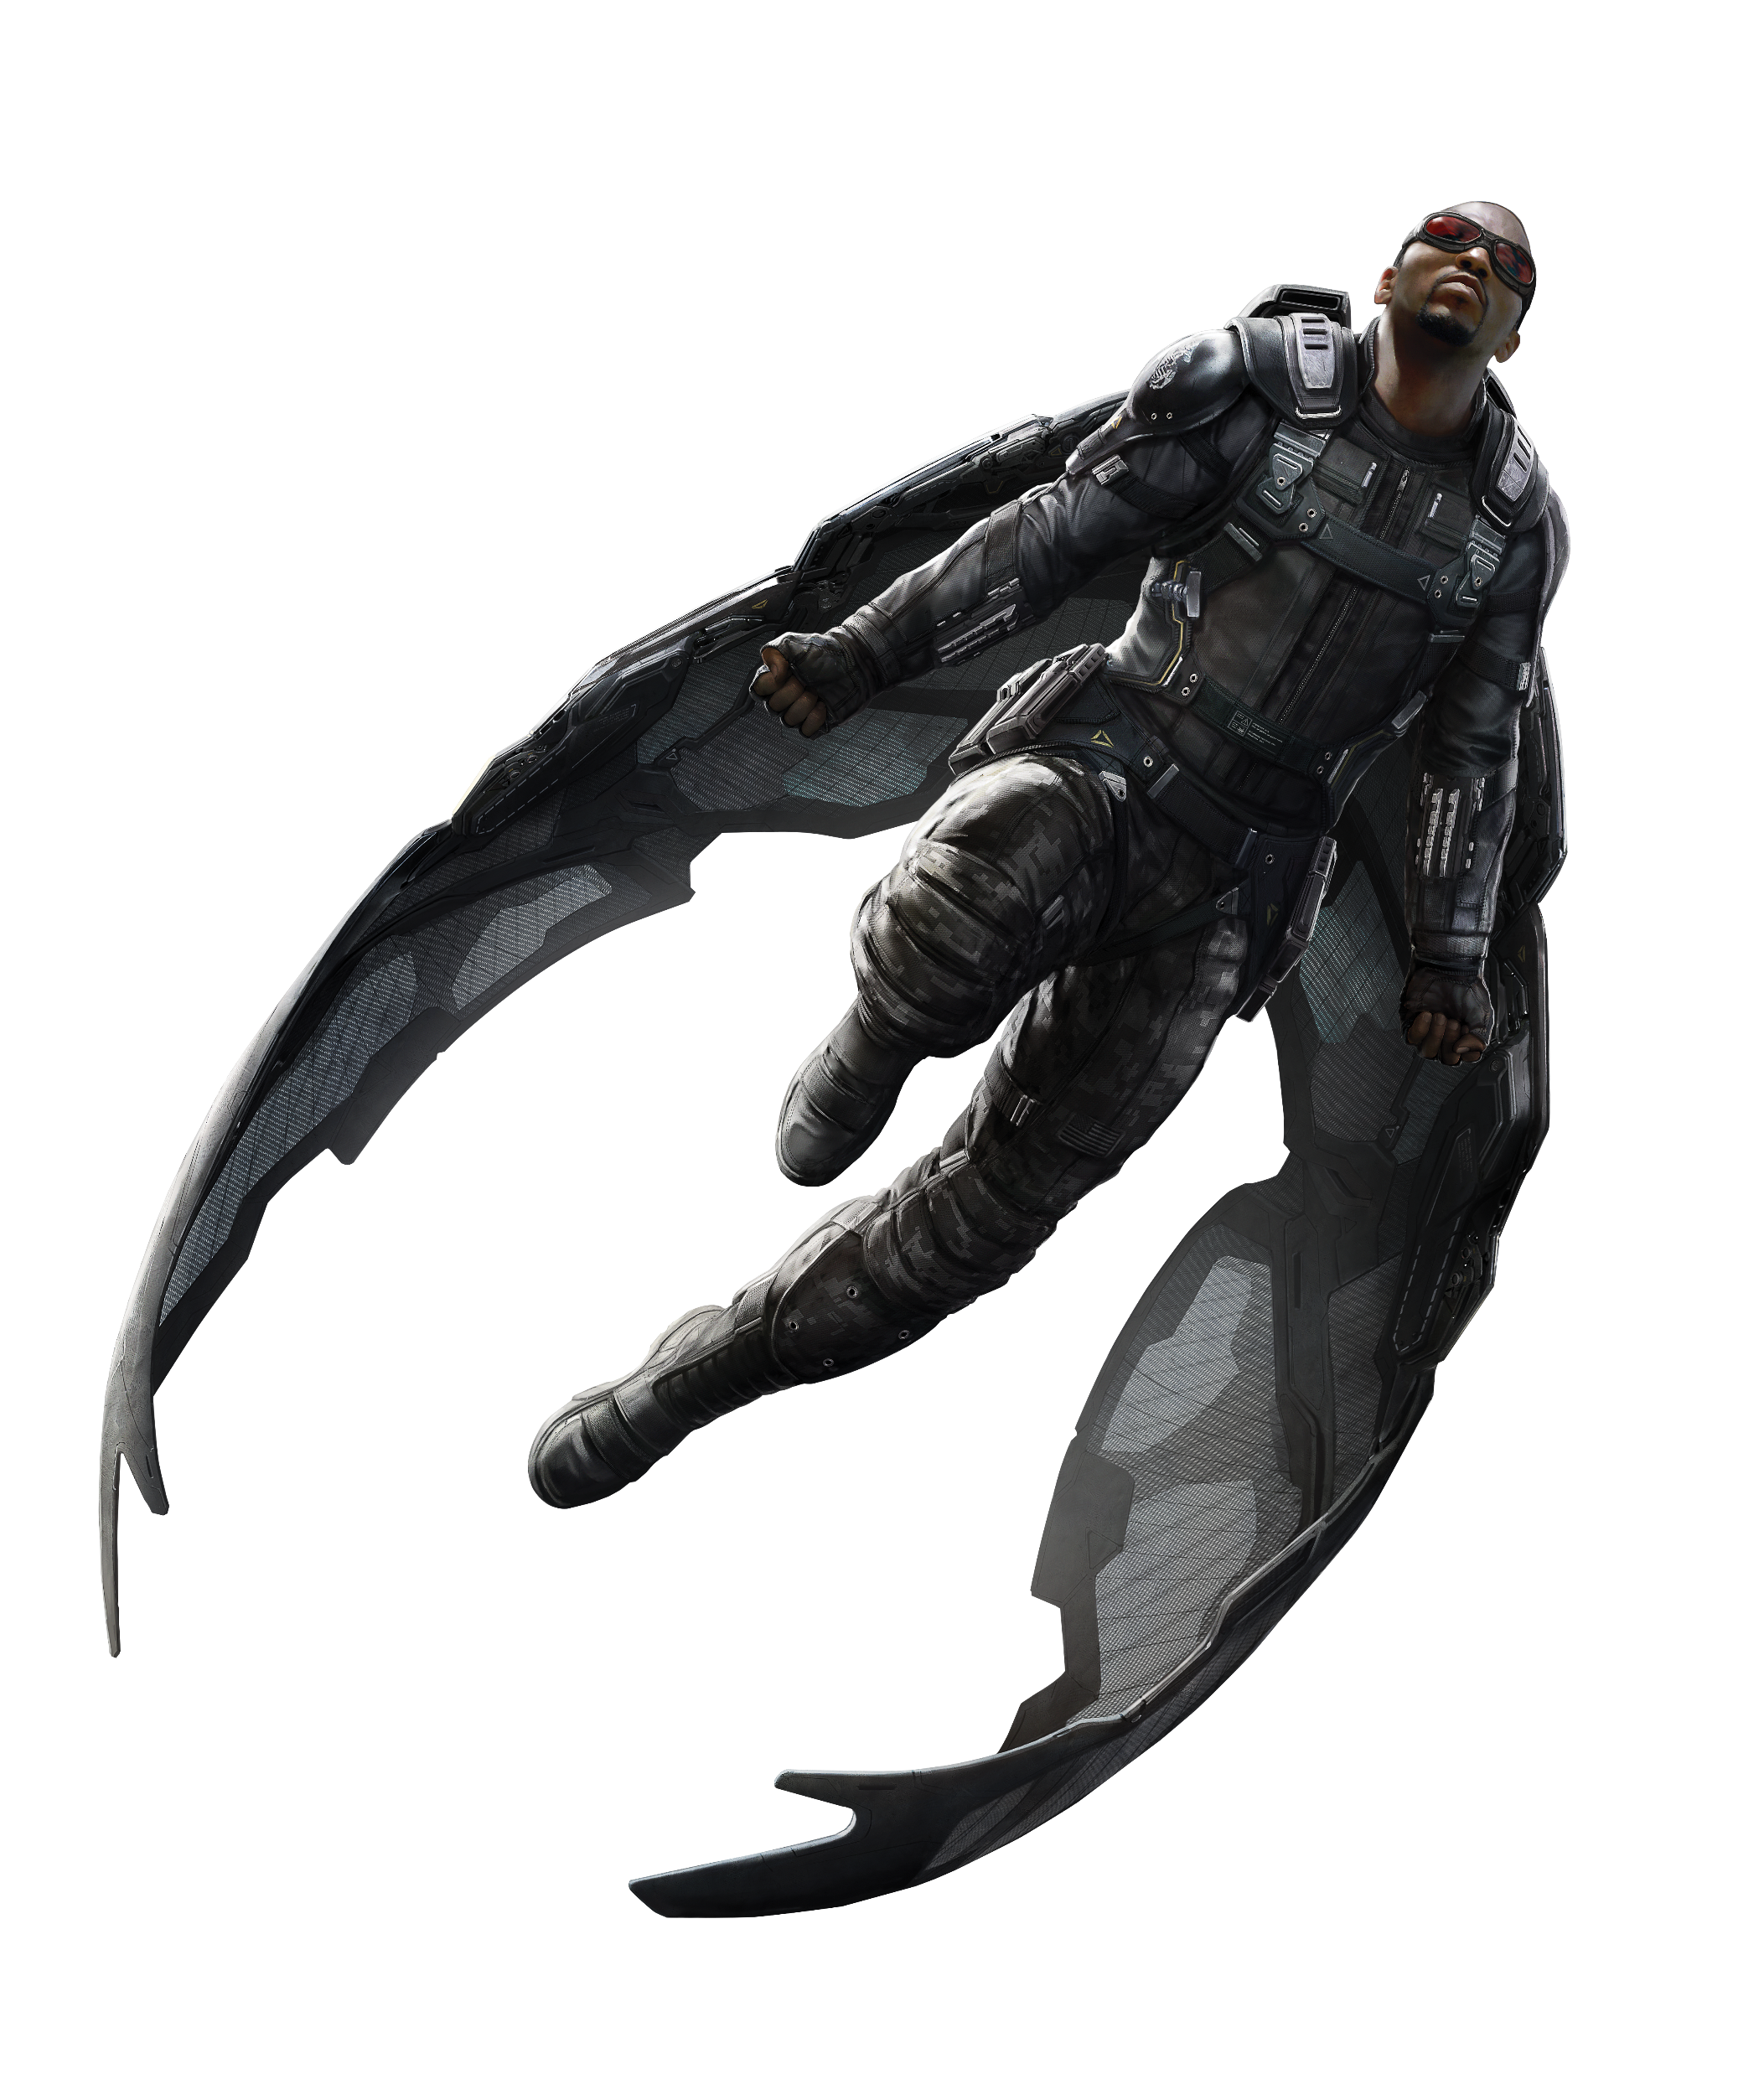
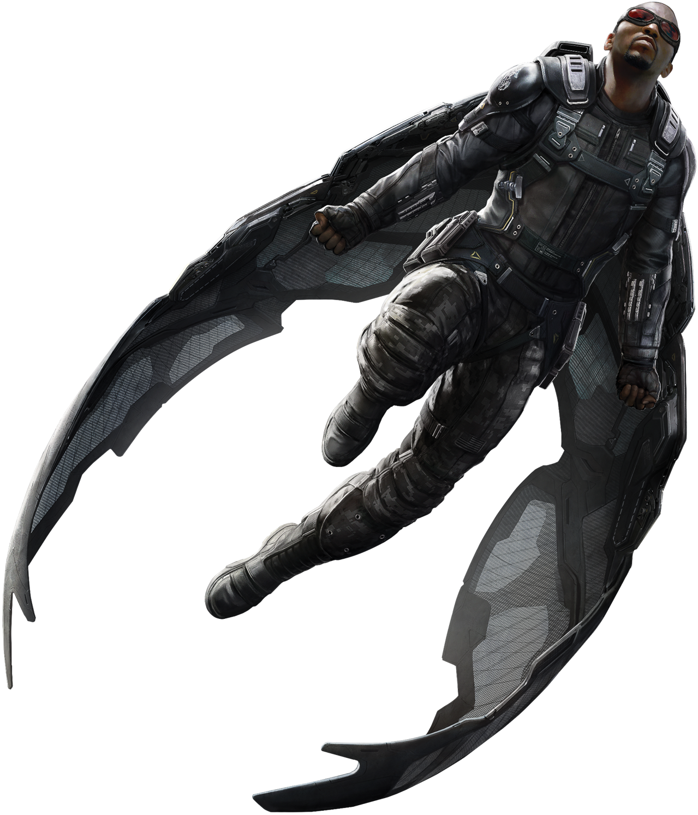
falcon
With a mental connection to all birds and a suit that gives him wings to fly, The Falcon has been both the partner to Captain America and an Avenger himself. Whether as a super hero or in his secret identity of social worker Sam Wilson, The Falcon dedicates his life to standing up for others.
Marvel - Avengers

